Slide 1
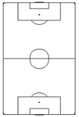
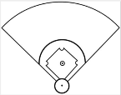
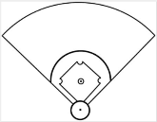
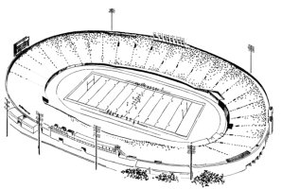
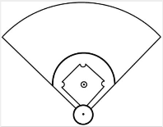
Plano Parkway
Local
Missions
ESL Classes
Entrance B
Lake
ESL
Midway Road
Marsh Lane
Main
Church
Children’s
Students’
Ministry
Commons
Ministry
Sports Fitness Center
West
Wing
P.C.A.
Chapel
W. Park Boulevard

